Slide 1
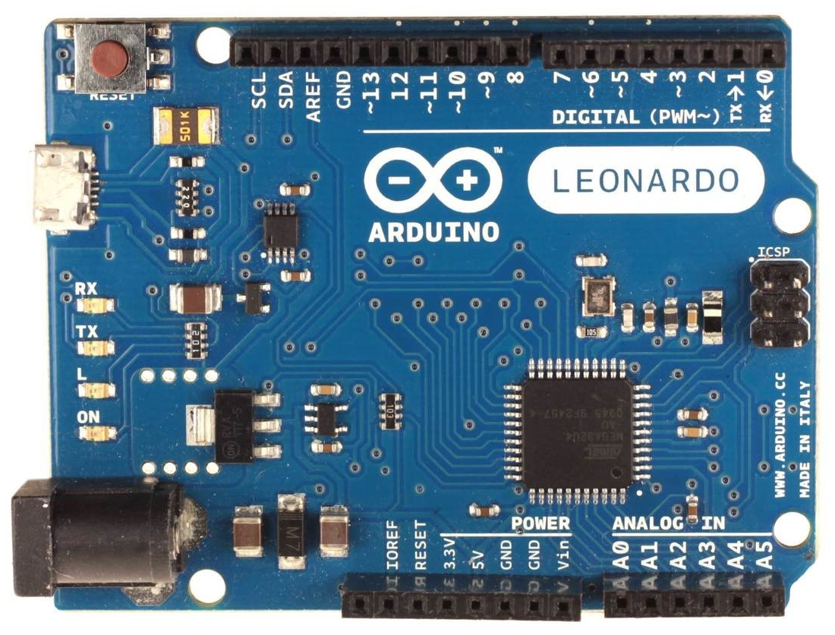
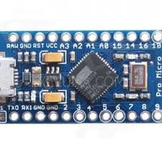
Arduino Leonardo or Micro
Arduino FFB wheel firmware v250 pinout:
GND - common ground
5V - VCC for all devices
A0 - throttle pot
A1 - brake pot (if LC* - clutch pot)
A2 - clutch pot (if LC* - handbrake pot, else button8)
A3 - handbrake pot (if LC* - button0, else button9, or R*)
A4, A5 - buttons 1,2 (v250, or XY shifter v250f)
RX - channel A encoder
TX - channel B encoder (v250, or center button v250wc)
2 - channel Z encoder or SDA (data) for i2C devices
3 - SCL (clock) for i2C devices (v250w, v250s, v250g)
4 - DT pin for HX711 (v250l, or button0 in v250, or R*)
5 - CLK pin for HX711 (v250l, or button7 in v250),
3rd PWM channel (down 250b), or
2nd PWM direction pin (250b, in 2CH PWM+DIR mode)
6 - DT_SR* (v250n, or button4 in v250)
7 - CLK_SR* (v250n, or button5 in v250)
8 - PL_SR* (v250n, or button6 in v250)
9 - 1st PWM channel (left)
10 - 2nd PWM channel (right)
11 - 1st PWM direction pin, or
motor (PWM) enable pin,
4th PWM channel (up, v250b)
12 - button3
13 - FFB clipping LED
To activate buttons
short them to GND,
unless firmware with
“t” option for
button matrix
Arduino ProMicro
Replacement pinouts for ProMicro:
16 - PWM direction, or motor (PWM) enable
3 - FFB clipping LED, or SCL i2C
14 - button1
15 - button2
2 - button3 (v250m), or
encoder Z-index (v250zm), or
center button (v250cm), or
SDA i2C (v250sm, v250wm, v250gm)
Hat Switch (v250h):
Button0 - up
Button1 - right
Button2 - down
Button3 - left
*LC - load cell with HX711 (v250l)
*R - reverse gear button for XY shifter (v250f)
*SR - shift register chip or nano button box (v250n)

